Slide 1
Timebox 2 - Spotify Playlist Generator
BeatBuilders

Slide 2
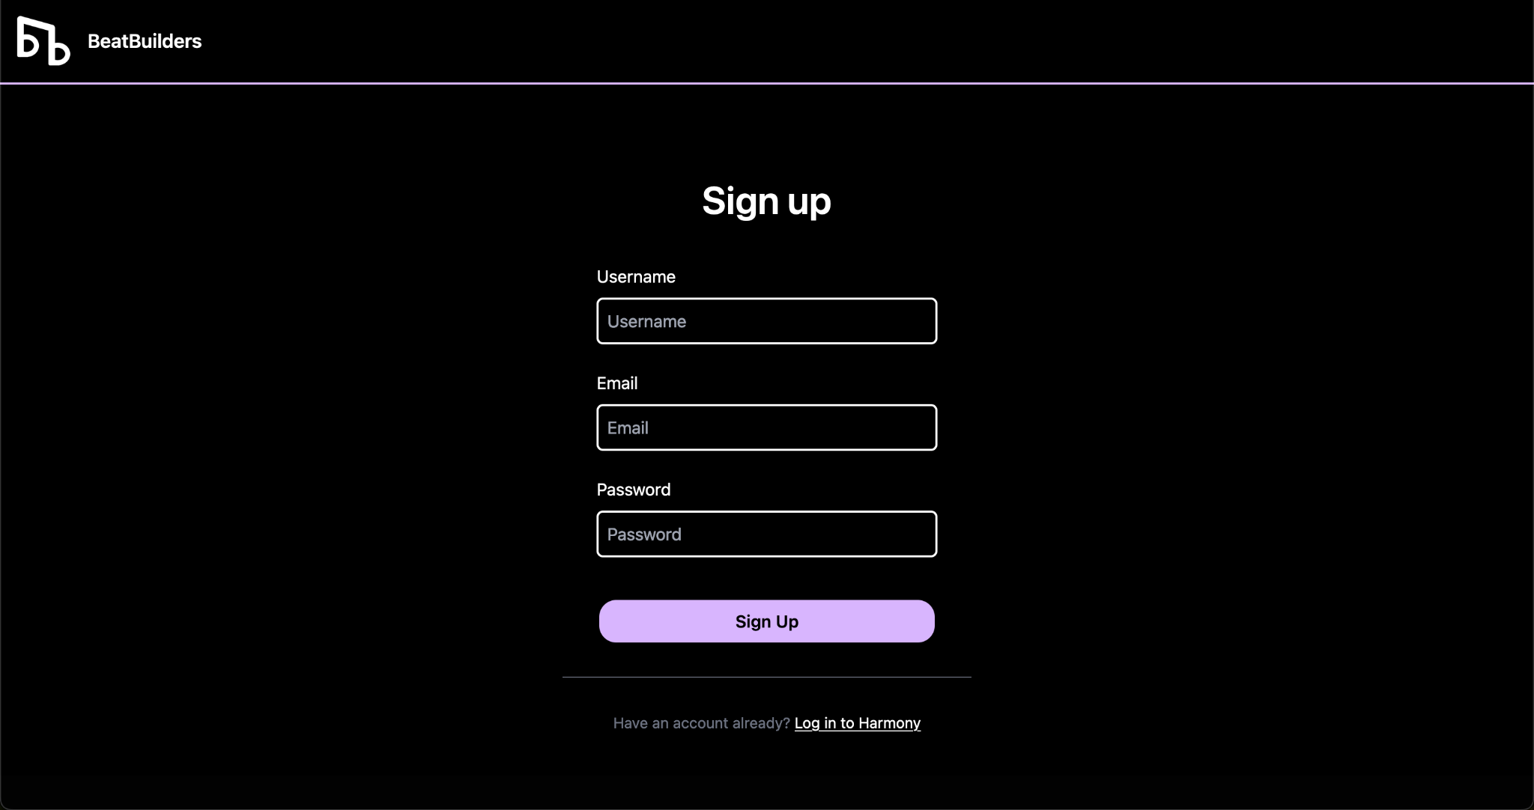
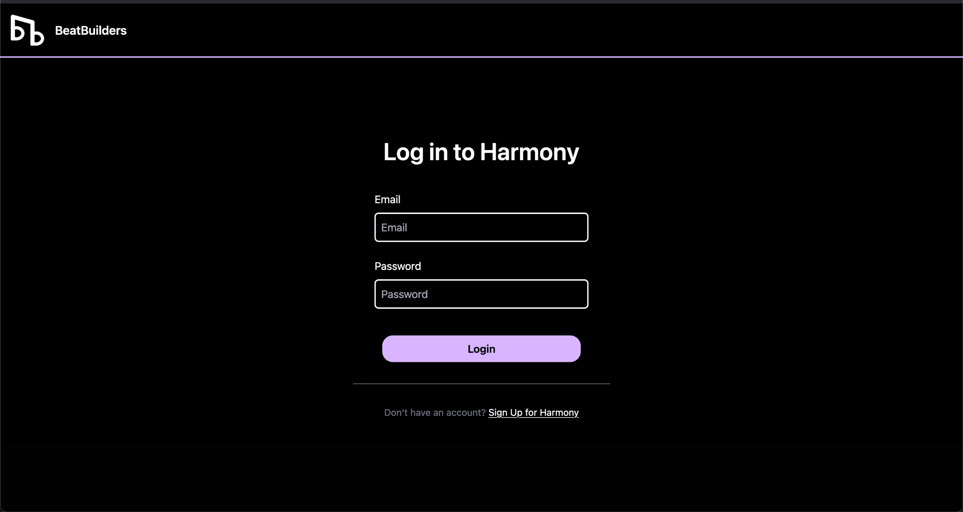
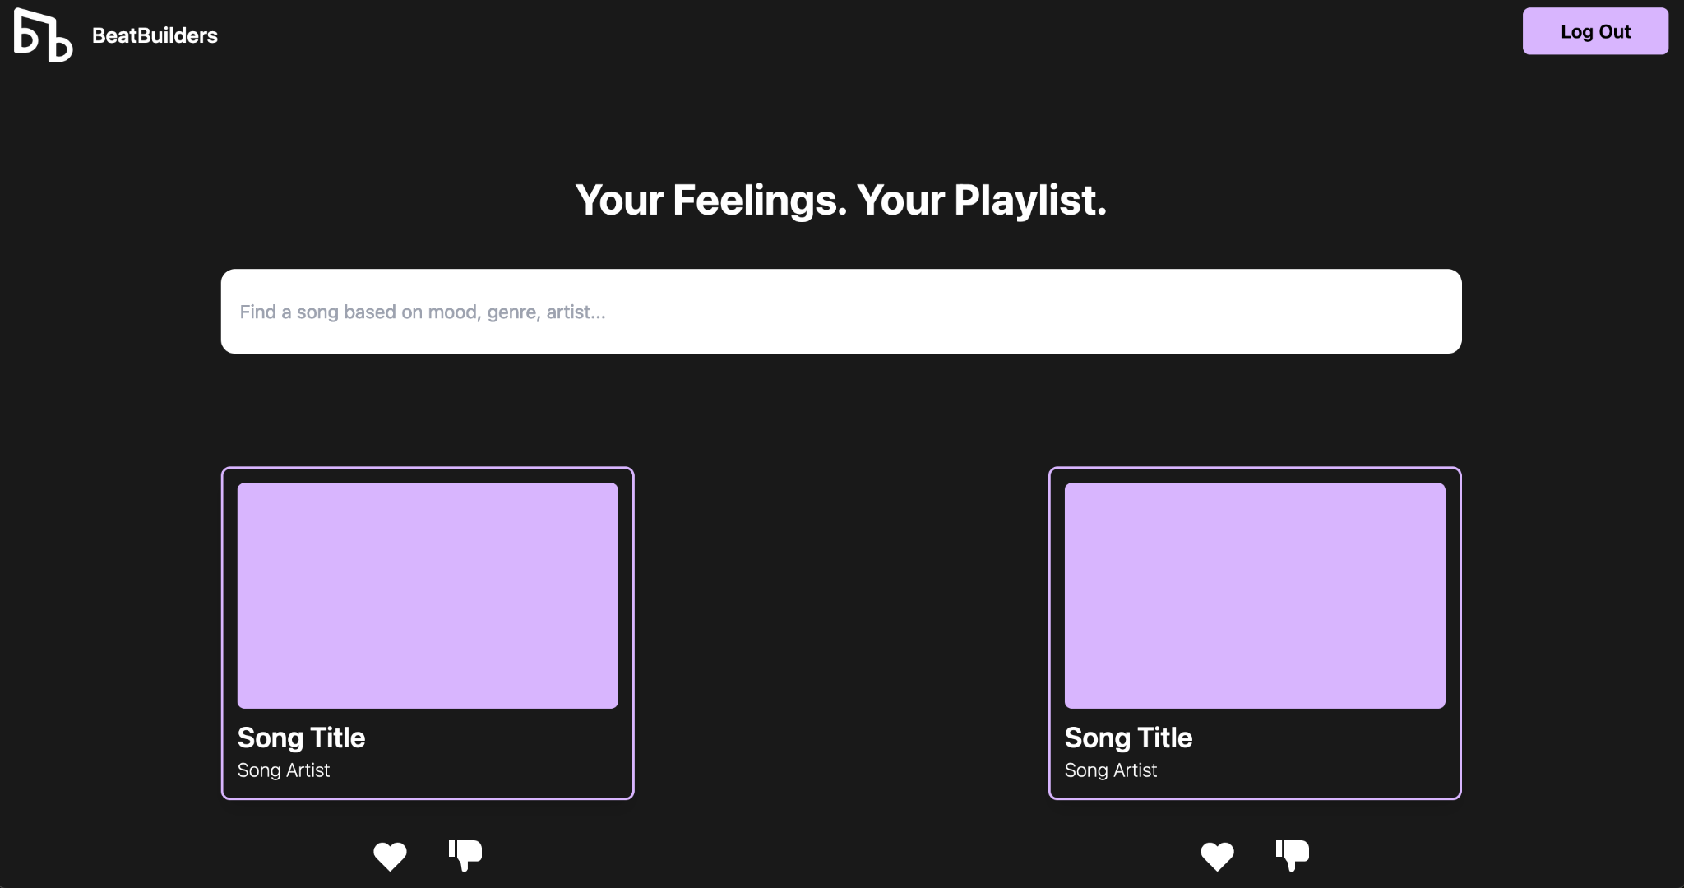
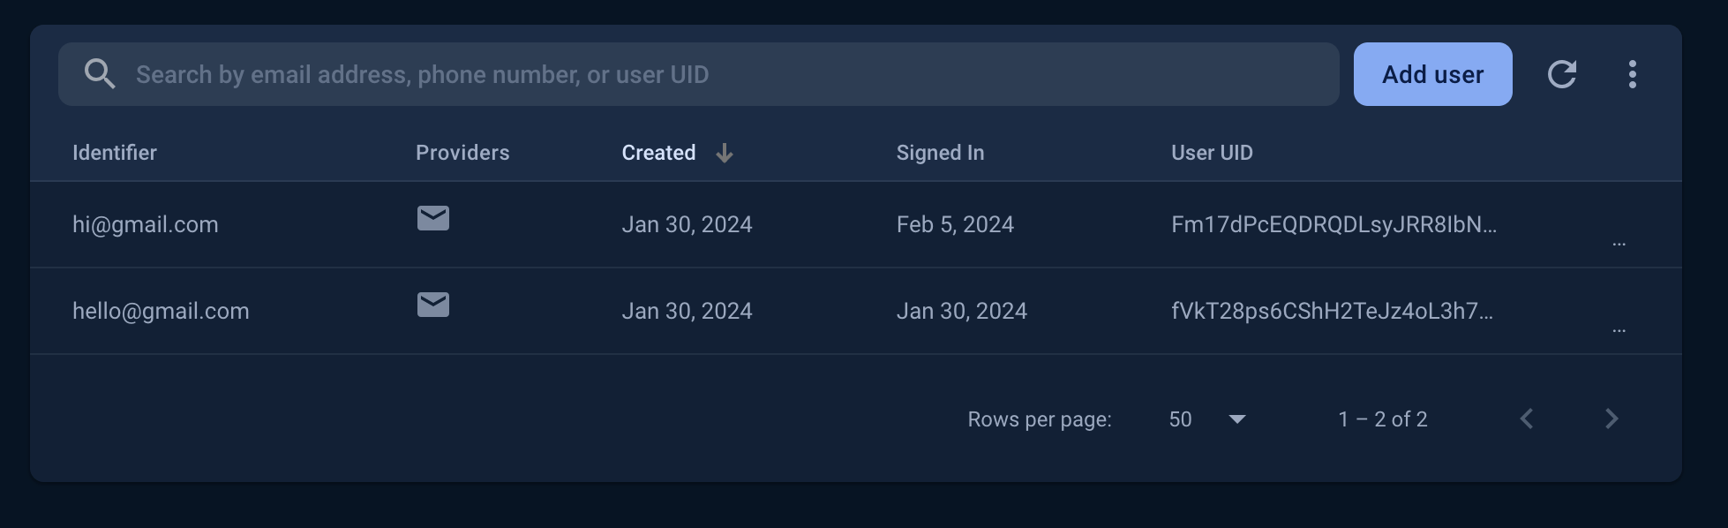

UI / Authentication
Notes:
Show class the demo
Sign up (show Firebase console with user and hashed password)
Login
Show main page

Slide 3
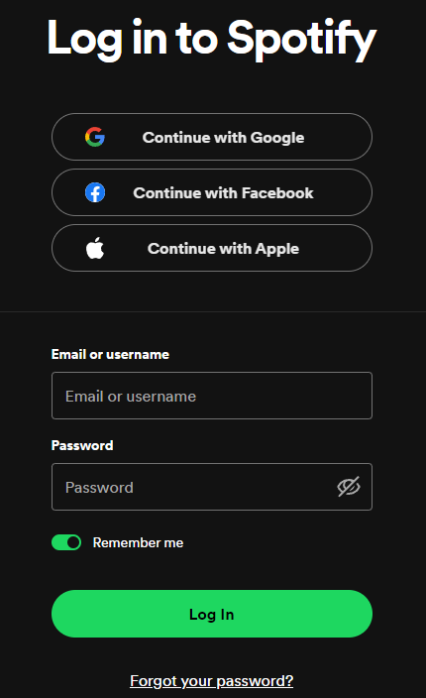
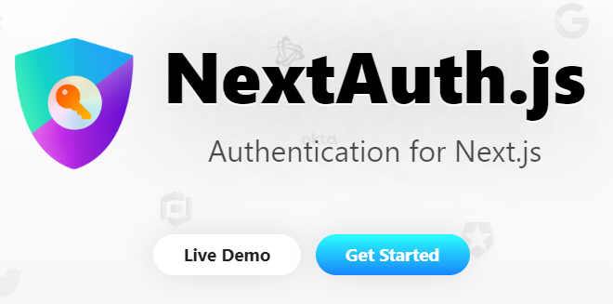
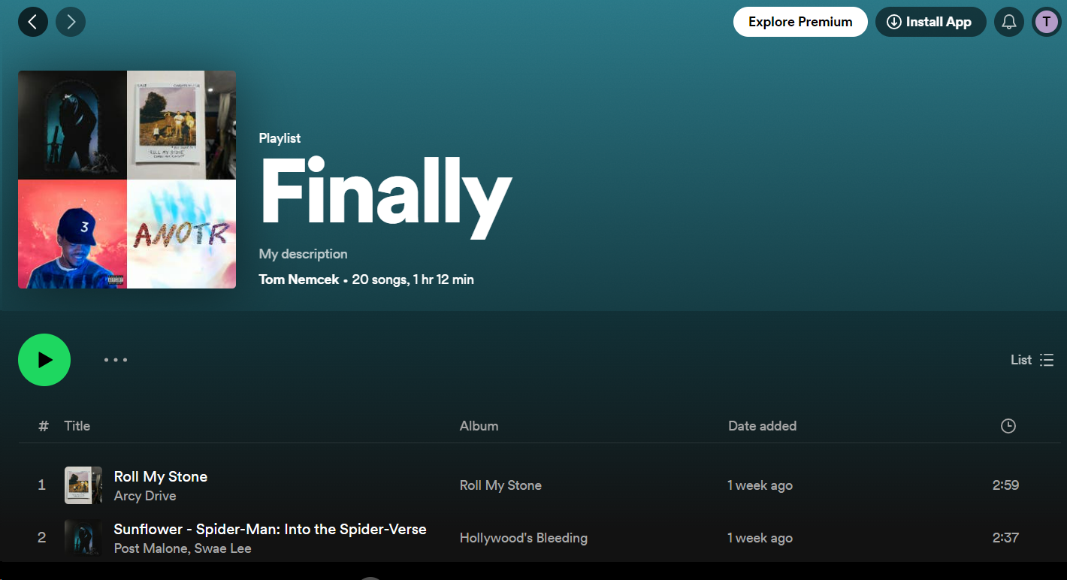
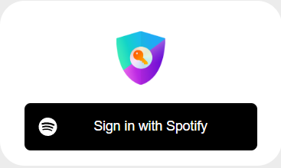
Spotify API/Authentication

Slide 4
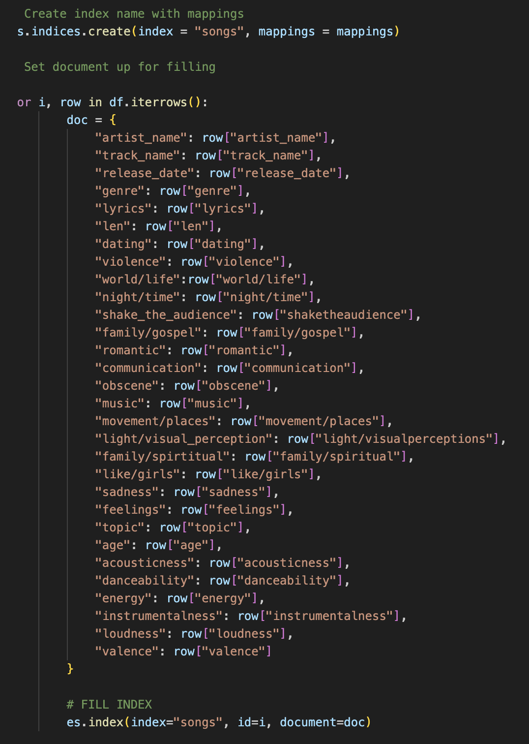
Dataset/Elasticsearch
Imported CSV Data:
Contains 28,372 songs and 30 columns
Pros:
Volume of Songs
Dispersion of Genre/Release Year
Information on each song
Cons:
Cut off at 2019, missing popular music
Index Creation
Python vs. Javascript
Utilizes song characteristics from Spotify
Docker Usage

Slide 5
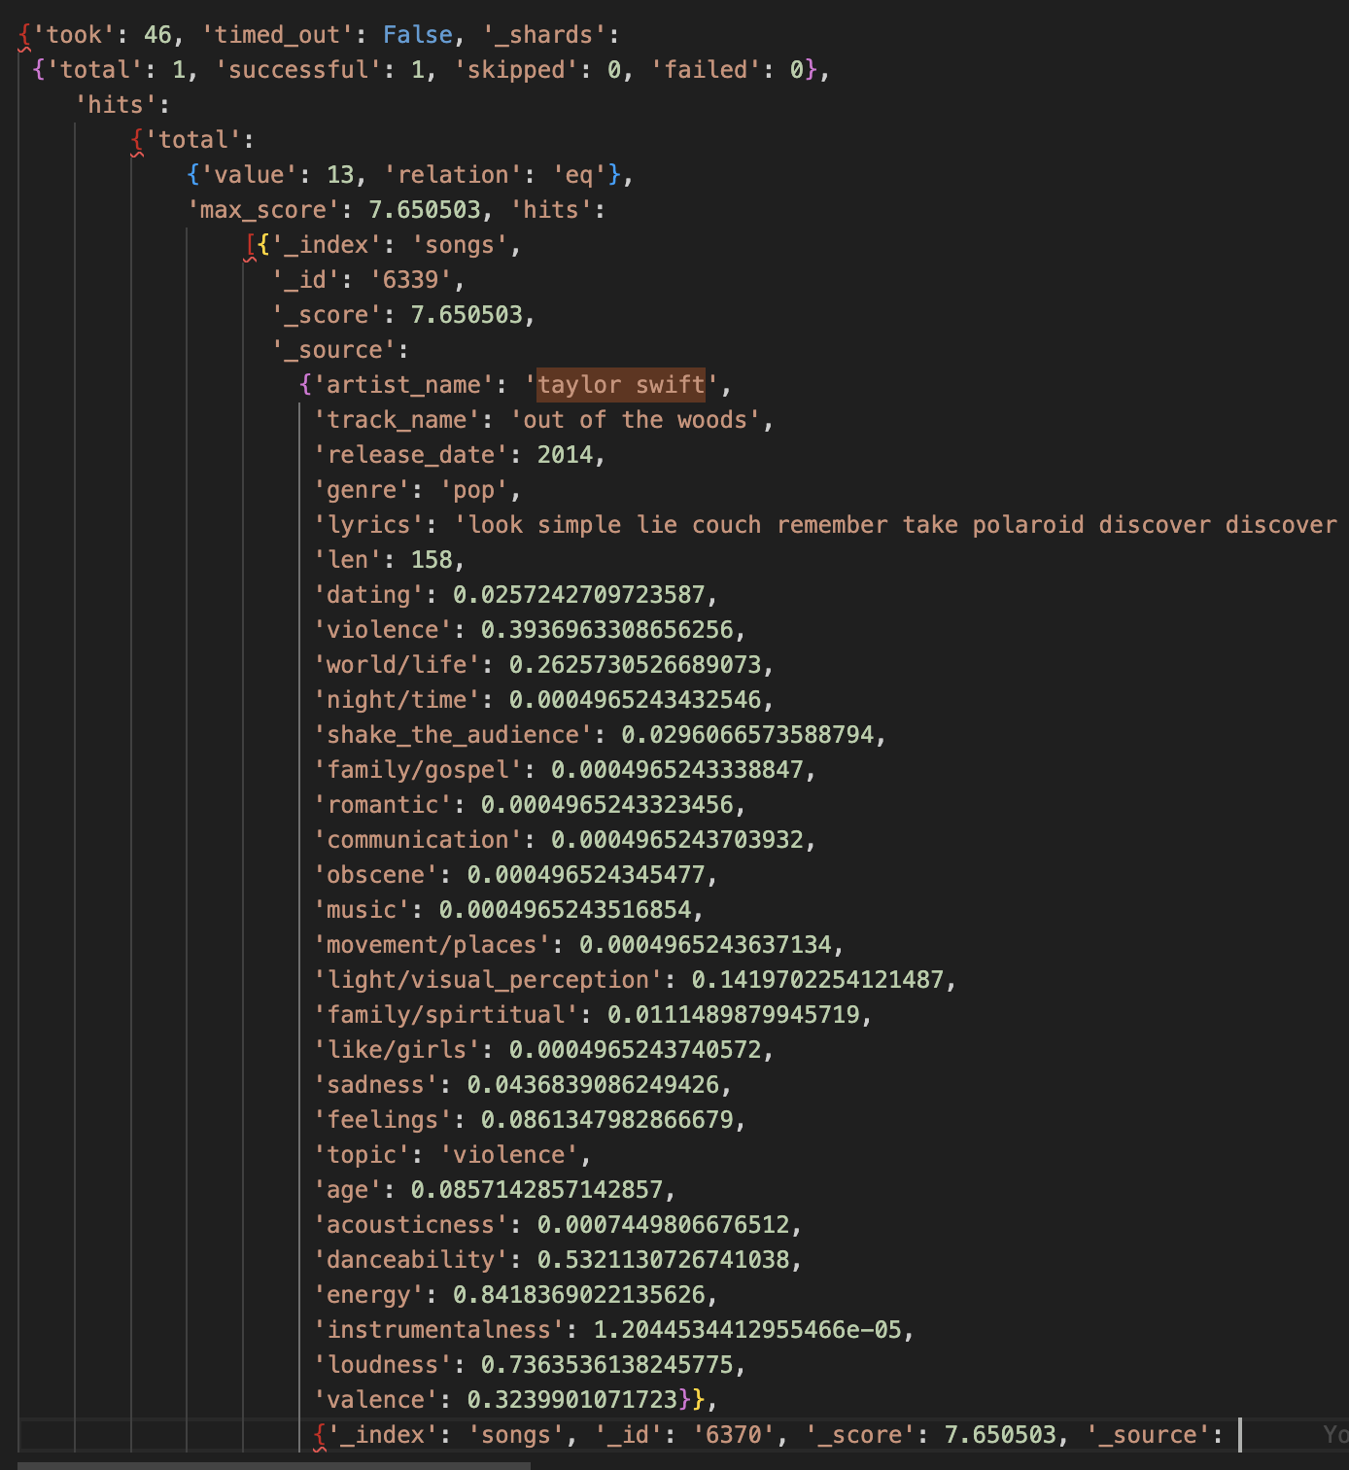
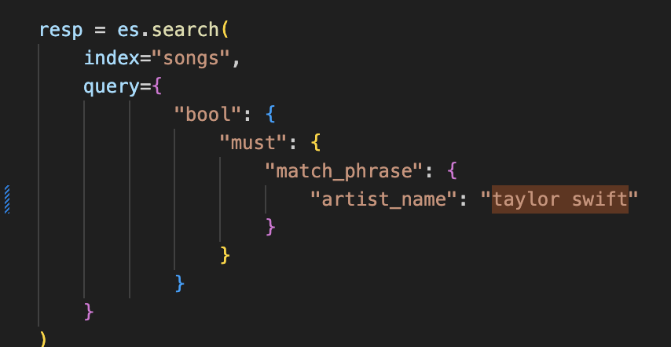
Dataset/Elasticsearch Example

Slide 6
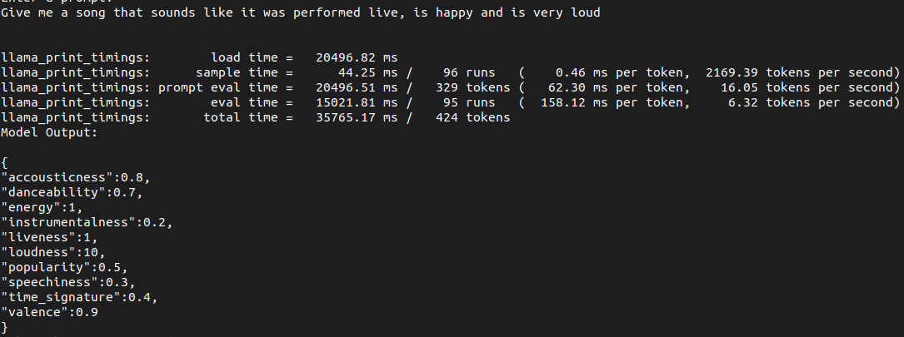
LLama 2
Strictly controlling LLM output into JSON
Teaches the LLM what each song attribute means

Slide 7
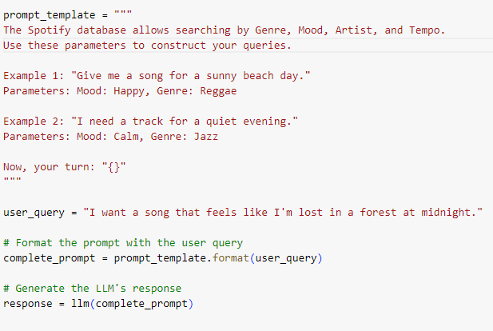
Llama 2 continued
Prompt Templates, and few-shot examples
Notes:
With the prompt template we can provide explicit context for what we want, or we can do something called few-shot prompting where we give a few "golden-examples" of what we want and it will do it's best to adhere to those golden exmaples, kind of like implicitly picking up on what we want
.l

Slide 8
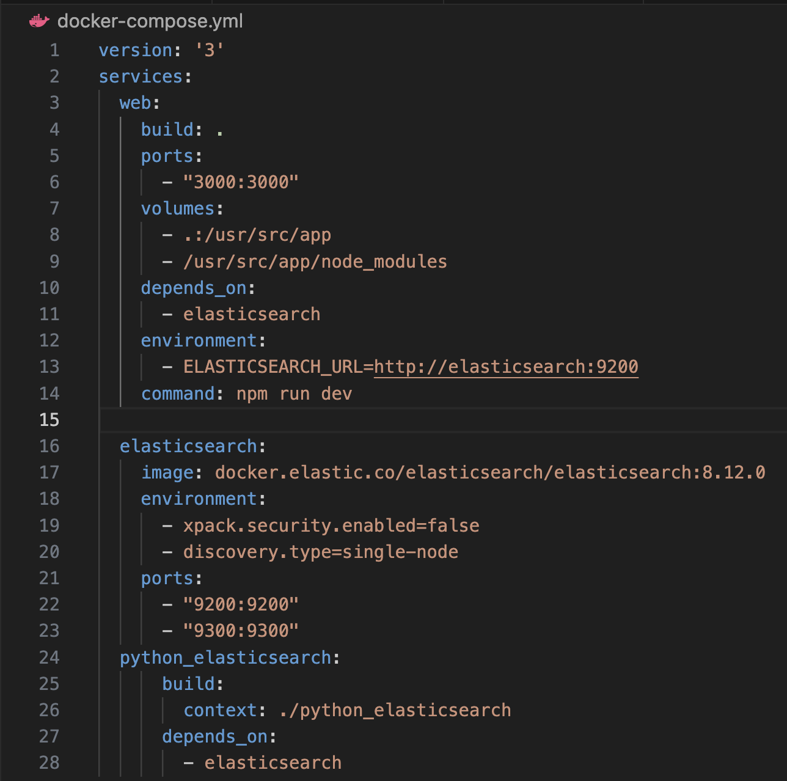
Docker Implementation
We are using Docker to keep our components working together as expected
Created containers for each component in the project so far
All containers are brought up through our docker-compose file

Slide 9
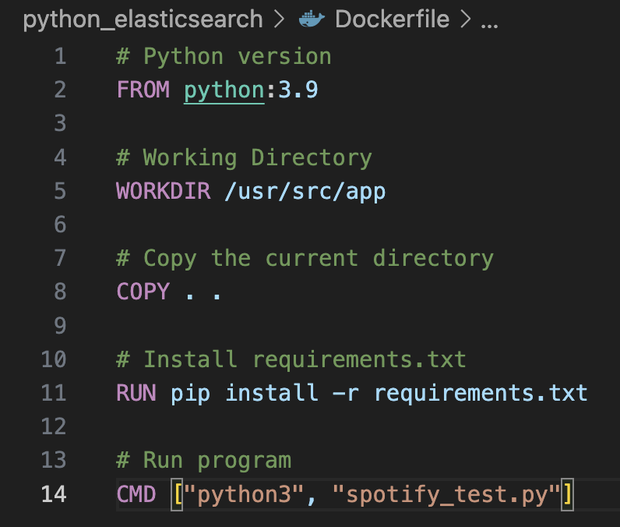
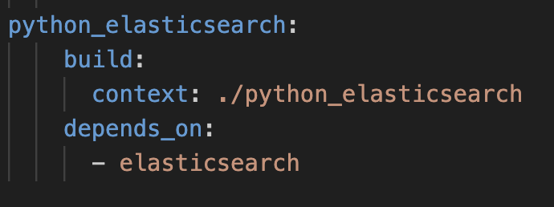
Docker Implementation
Dockerfiles build a container image
The Docker-compose file calls the Dockerfile’s containers for all components in the project to build and run
Dockerfile
Docker-compose section

Slide 10
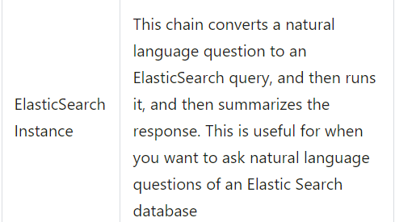
Next Steps
Connecting Llama 2 output to elasticsearch
ElasticSearch Database Chain --------->
Use web app inputs as Llama 2 input
Display elasticsearch output on web app
Improve routing between website pages

